Slide 1

Web Project for Exchange Student
SKKUEXS
김주원 | 서현원 | 이하은 | 한희근

Slide 2
Index
Overview
Role
Design
Implementation
Challenges
Limitation
1
4
2
5
3
6

Slide 3
Overview
(Objective, milestone)

Slide 4
Objective
Functional inconvenience of SKKU learning report website
Lack of community for exchange student
Difficulty in finding a ‘right/proper’ information
Problem
Provide summary and analysis Of SKKU learning report
Web community for Exchange students
Solution

Slide 5
Milestone
To – do Week | 3 | 4 | 5 | 6 | 7 | 8 | 9 | 10 | 11 | 12 | 13
Proposal & Study
Data Collecting
Data Processing (NLP)
Front-end (Planning & UI/UX)
Back-end (Server & DB Design)
Beta Test
✅
✅
✅
✅
✅
✅
✅
5

Slide 6
Role

Slide 7
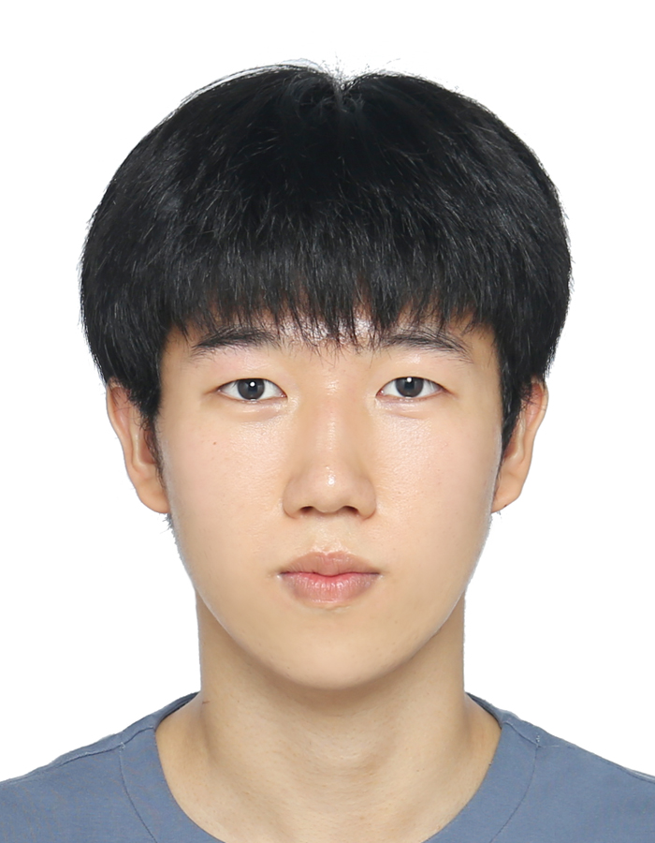
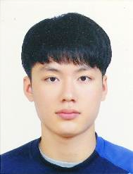

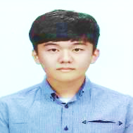
Work Assignment
Juwon Kim
Data Processing(.hwp)
Back-end Design
Hyunwon Seo
Data Processing(.pdf)
Back-end Design
Haeun Lee
Data Processing(.doc,docx)
Front-end Design
Huigeun Han
Data Processing(old)
Web Crawling
NLP model select
7

Slide 8
Design

Slide 9
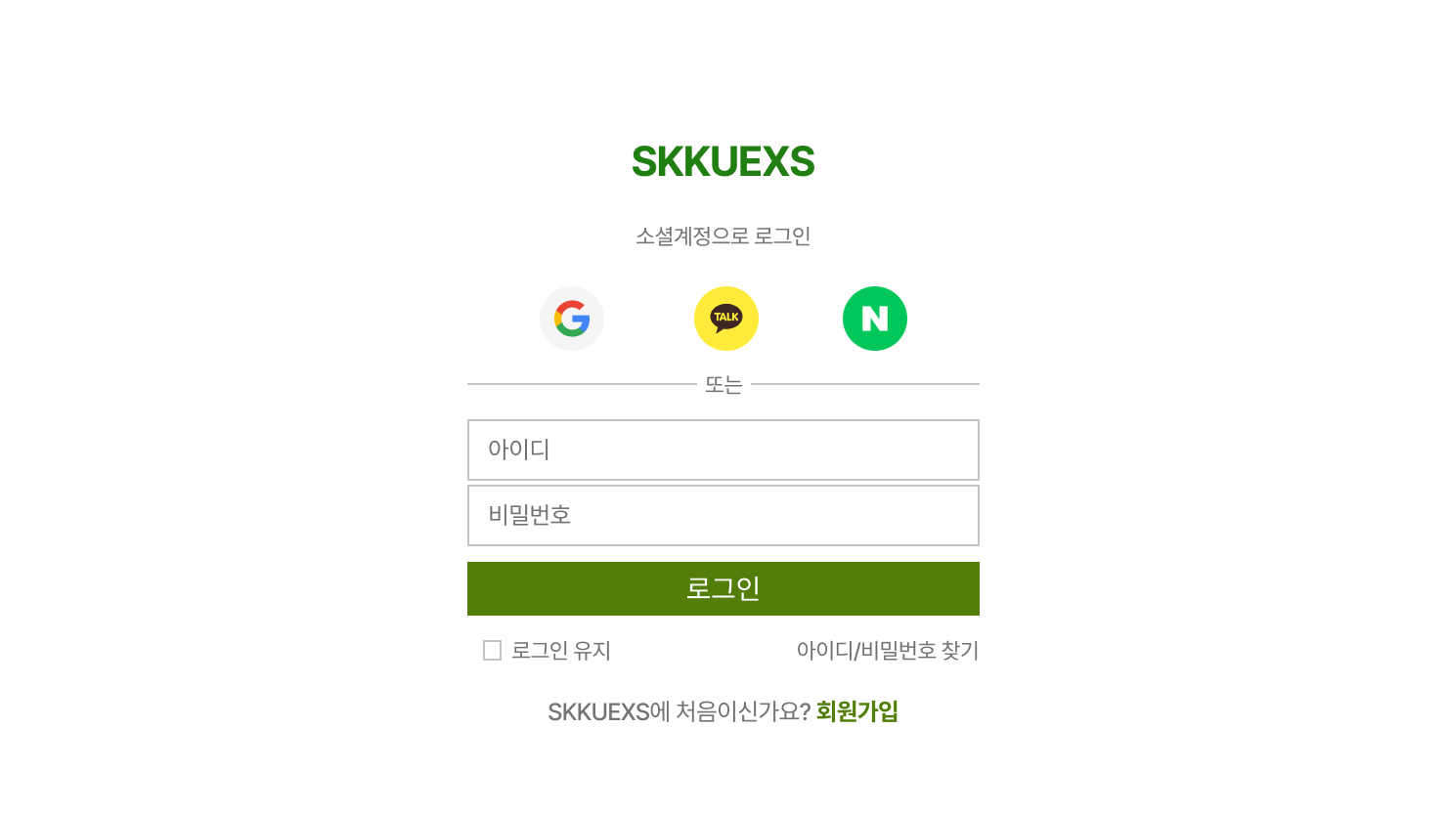

Front-end Design
Front-end Design

Slide 10
Front-end Design
Front-end Design

Slide 11
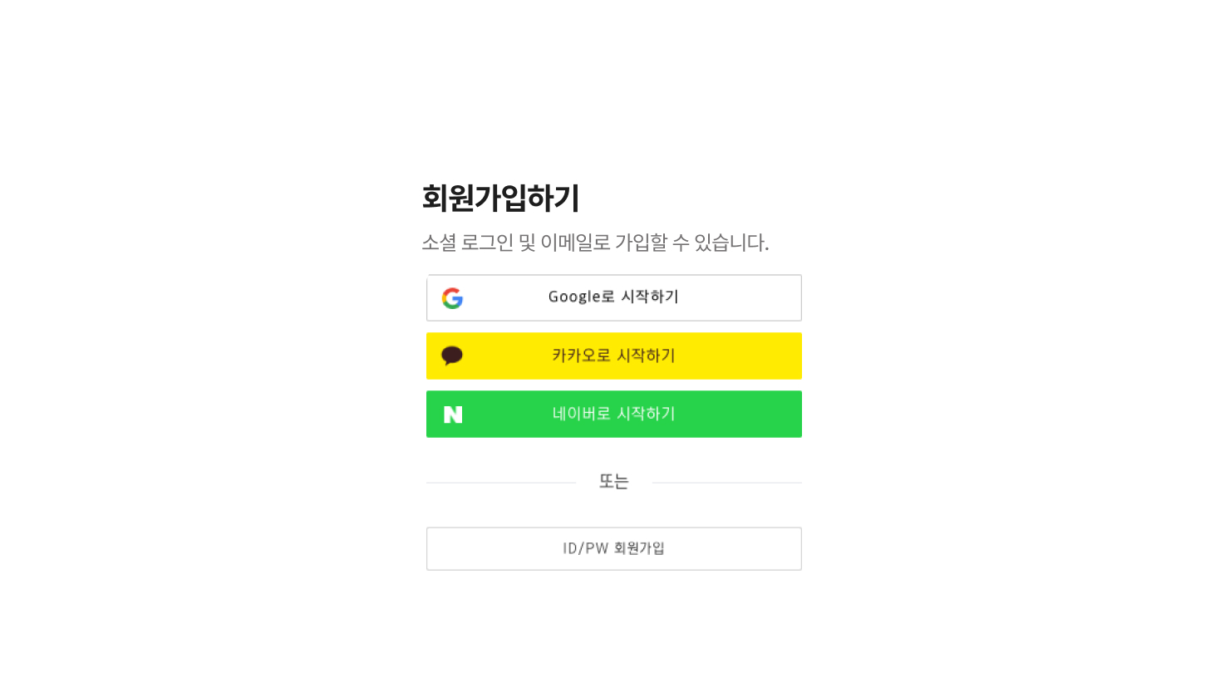
Front-end Design

Slide 12


Front-end Design
Front-end Design

Slide 13
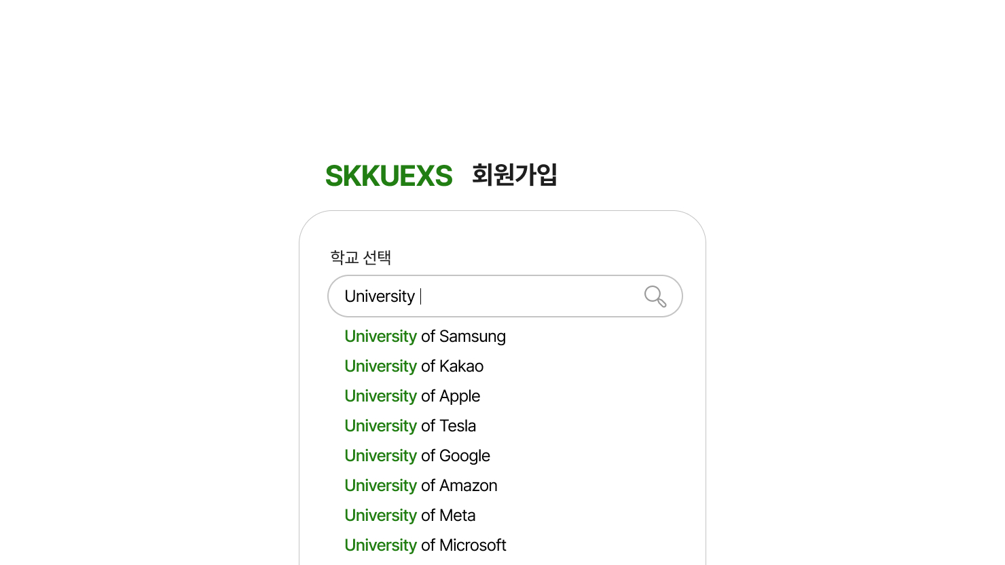
Front-end Design
Front-end Design

Slide 14
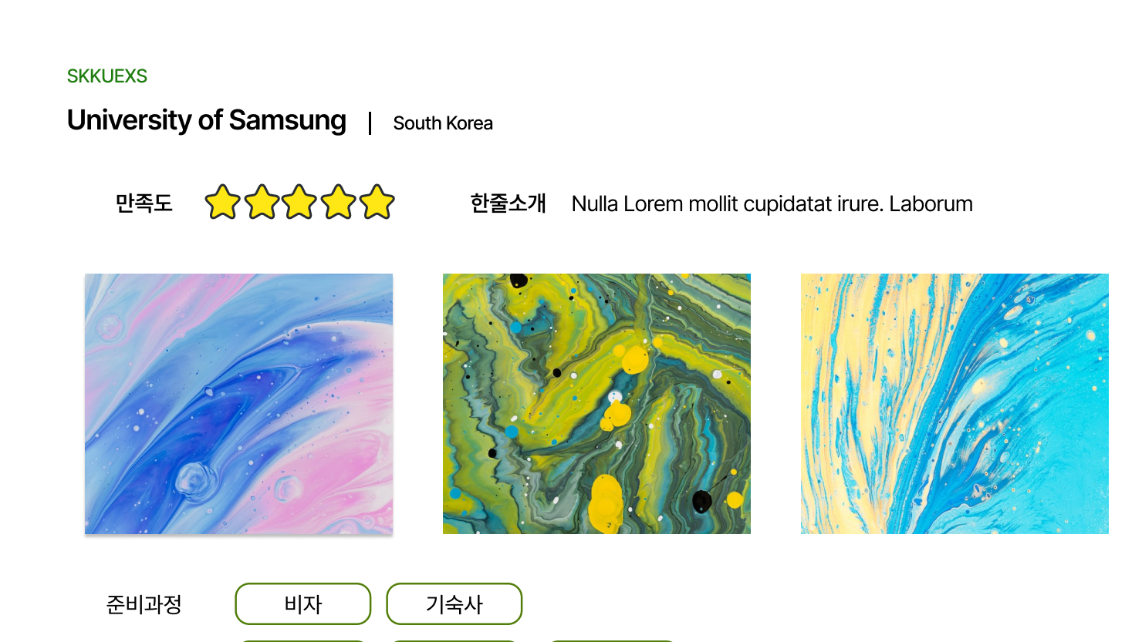
Front-end Design
Will be replaced by University Image

Slide 15
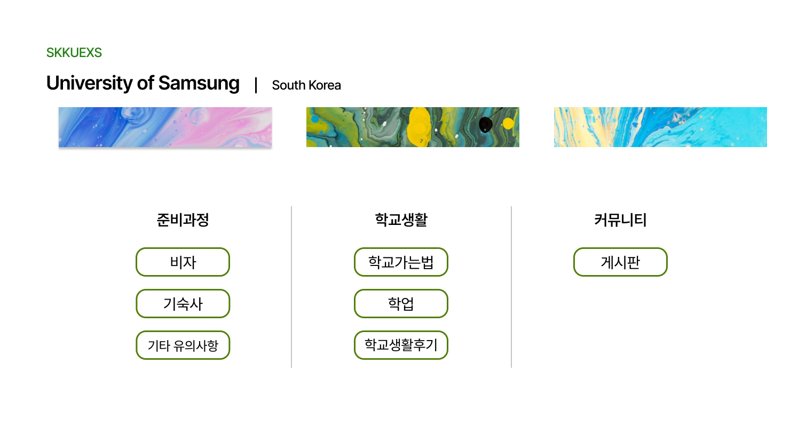
Front-end Design

Slide 16
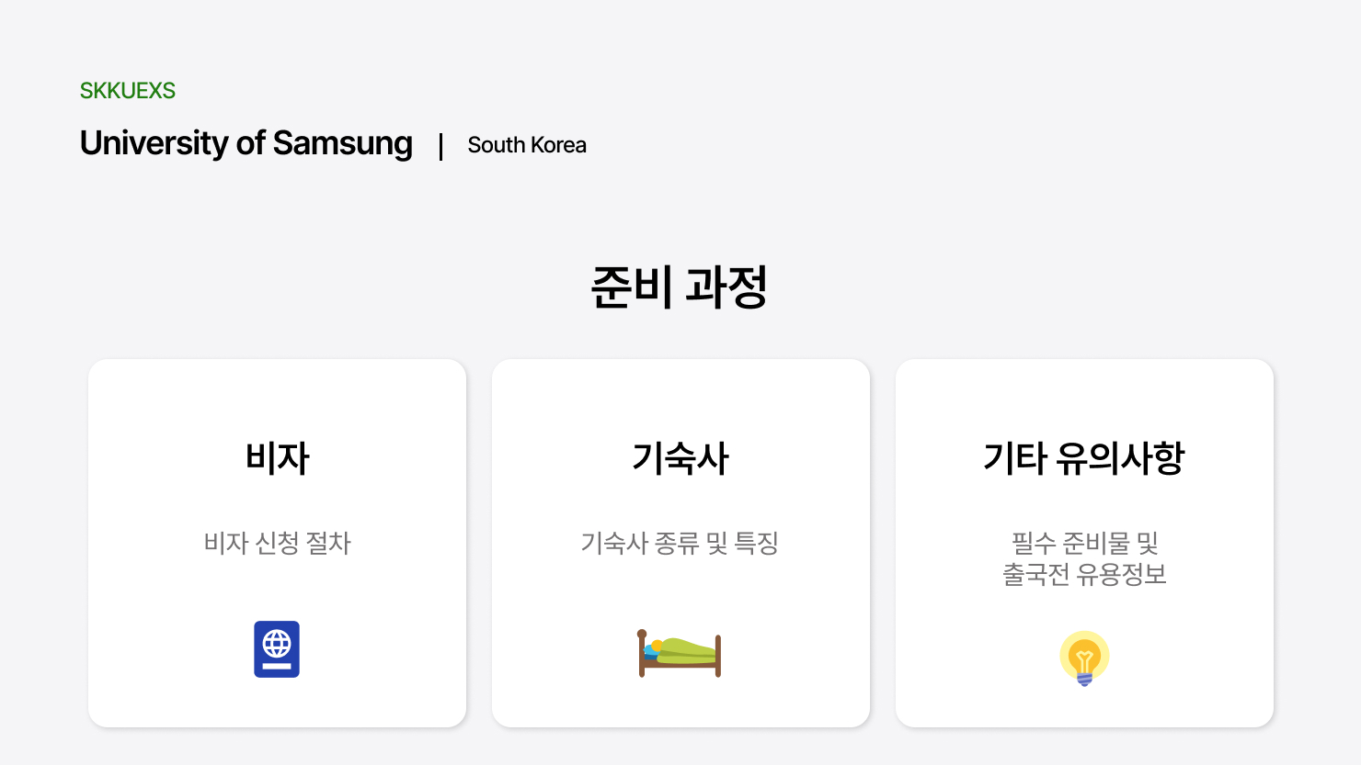

Slide 17
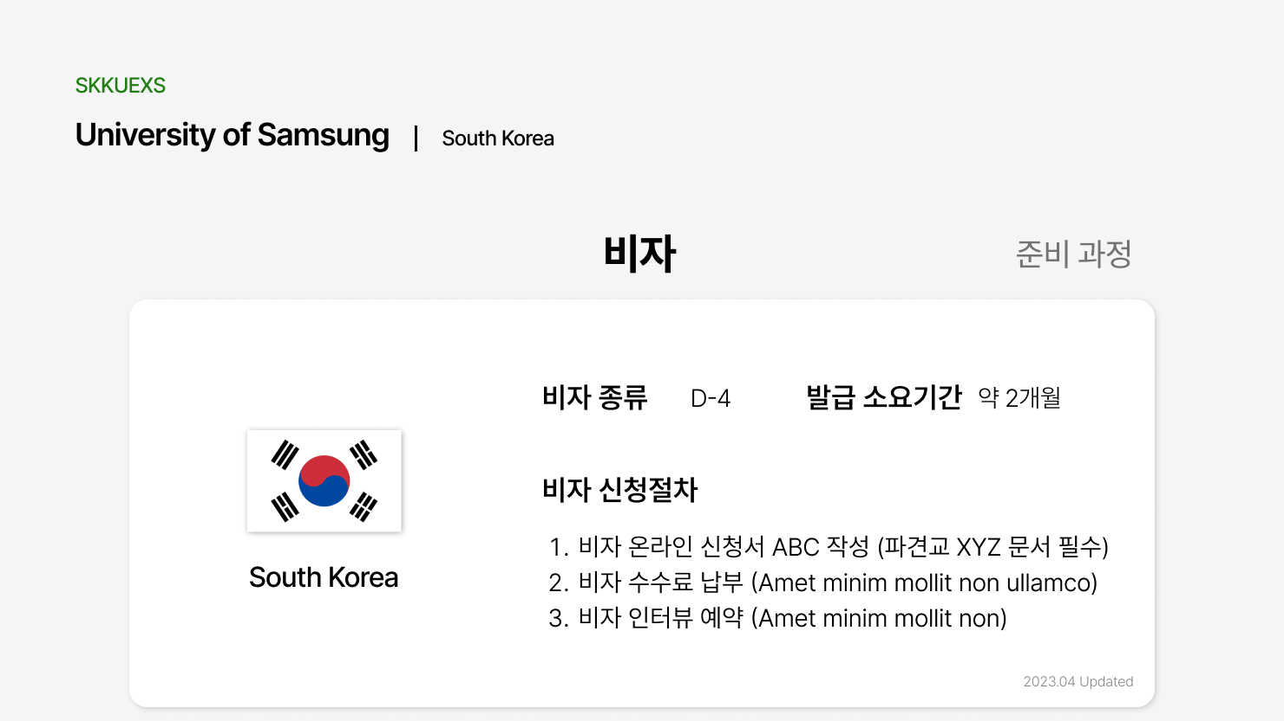

Slide 18
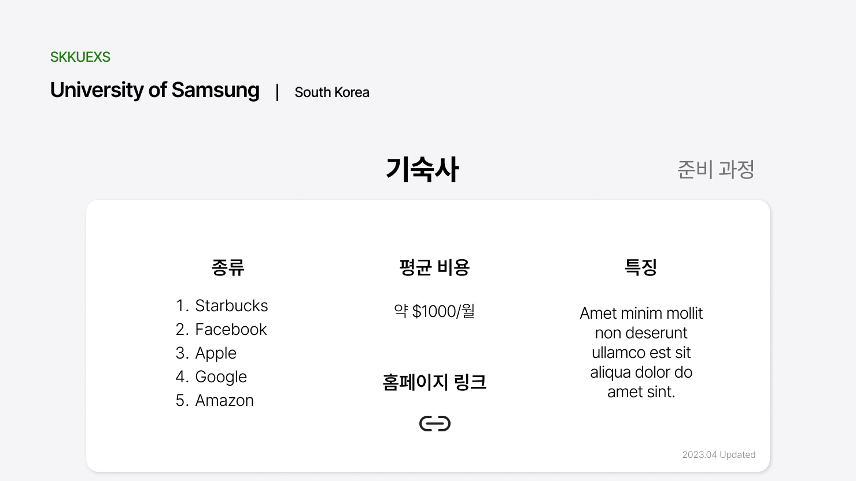

Slide 19
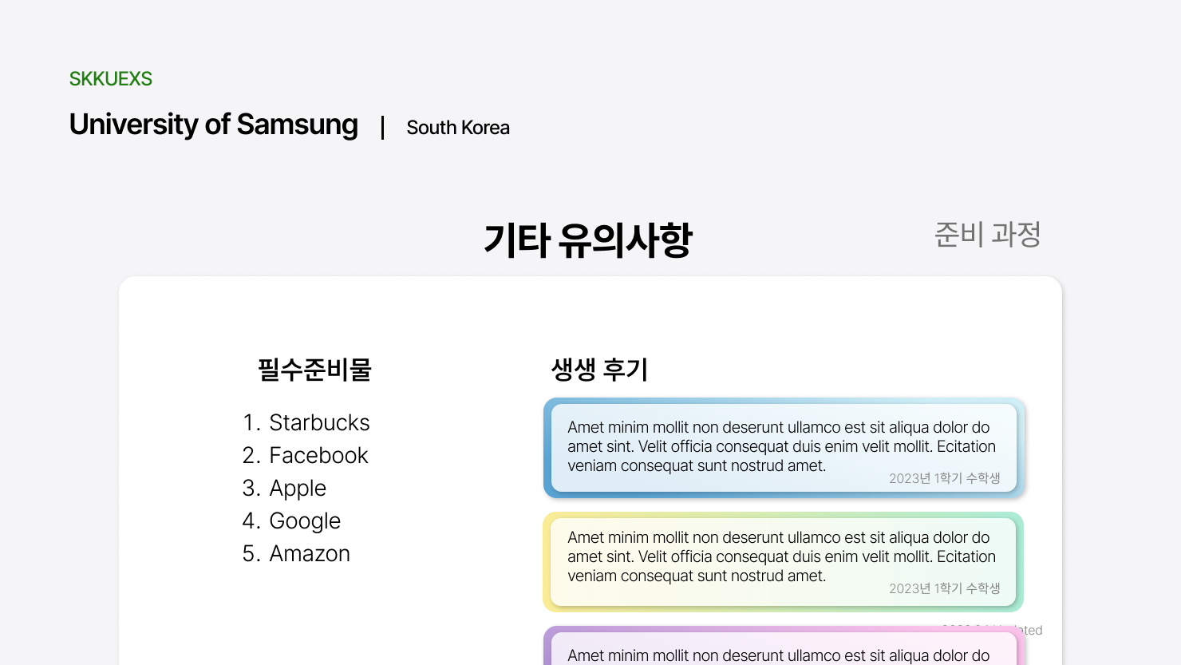

Slide 20
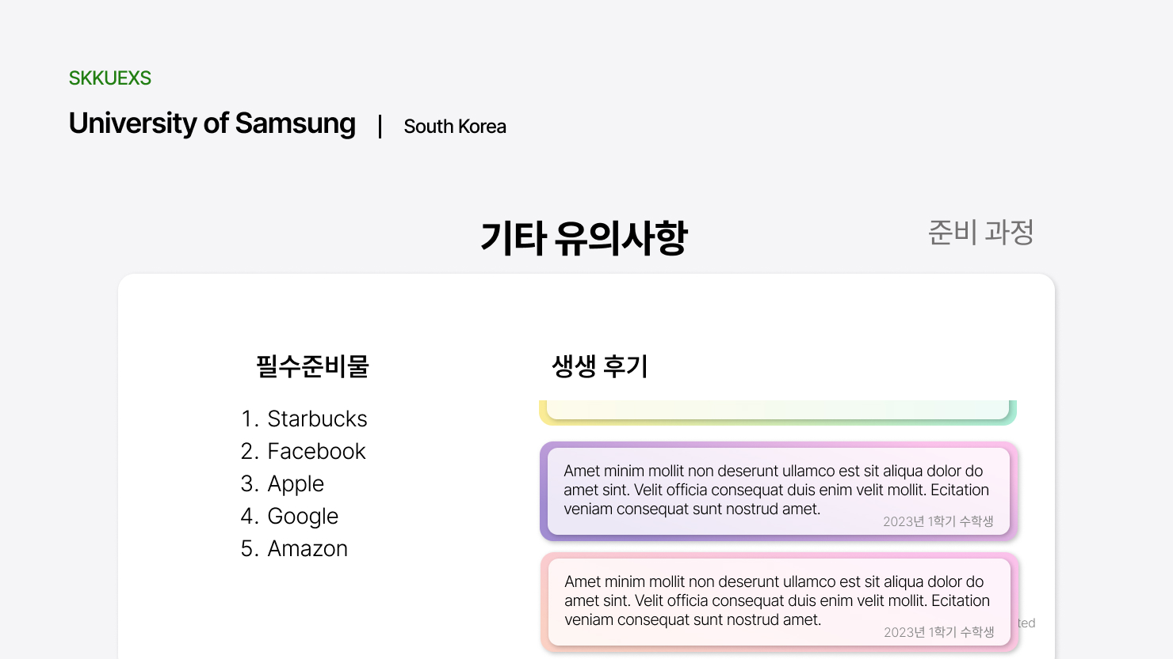

Slide 21
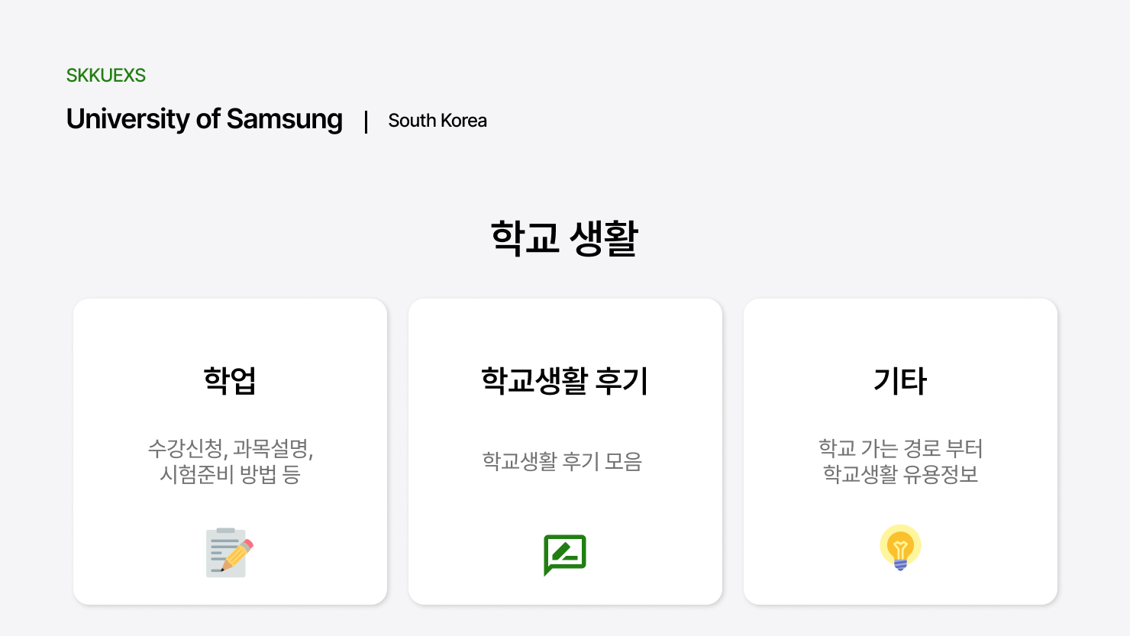

Slide 22
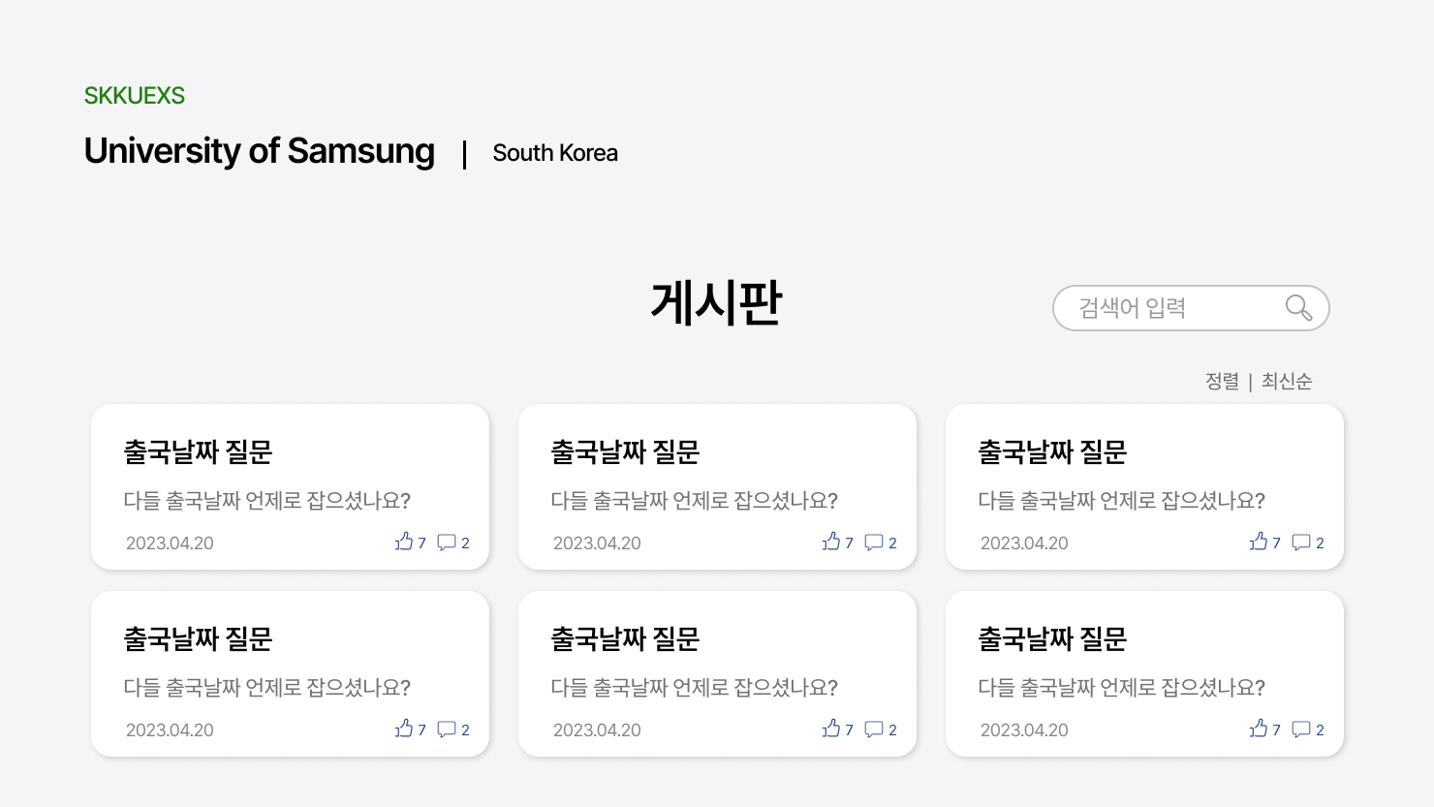

Slide 23
Implementation

Slide 24

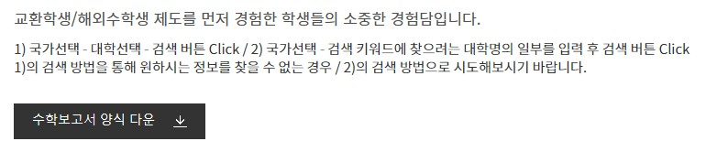
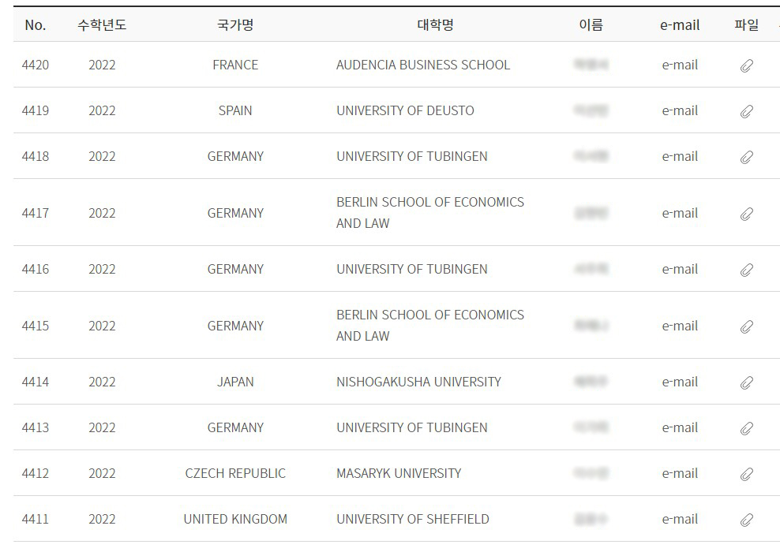



Implementation
24

Slide 25
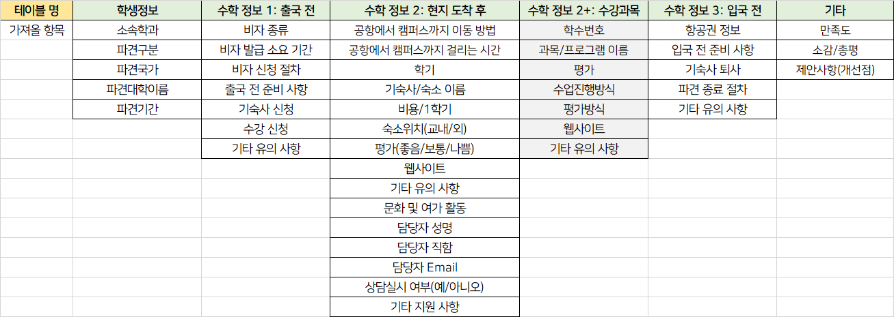
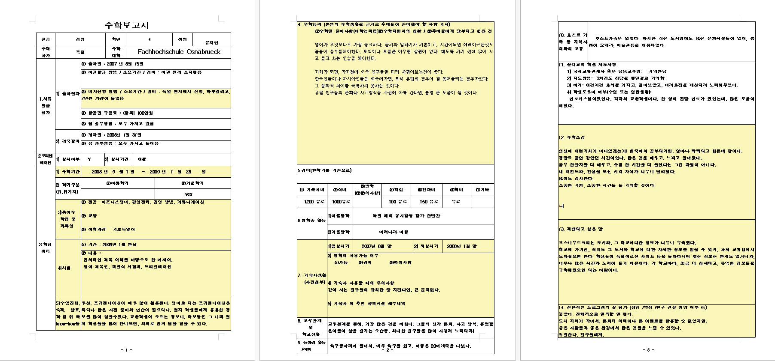
Implementation
25

Slide 26
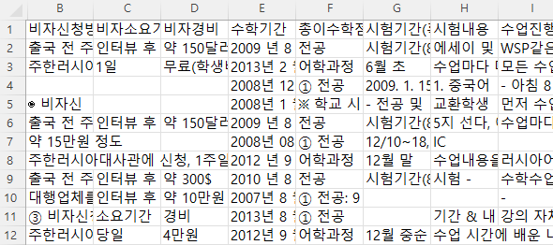
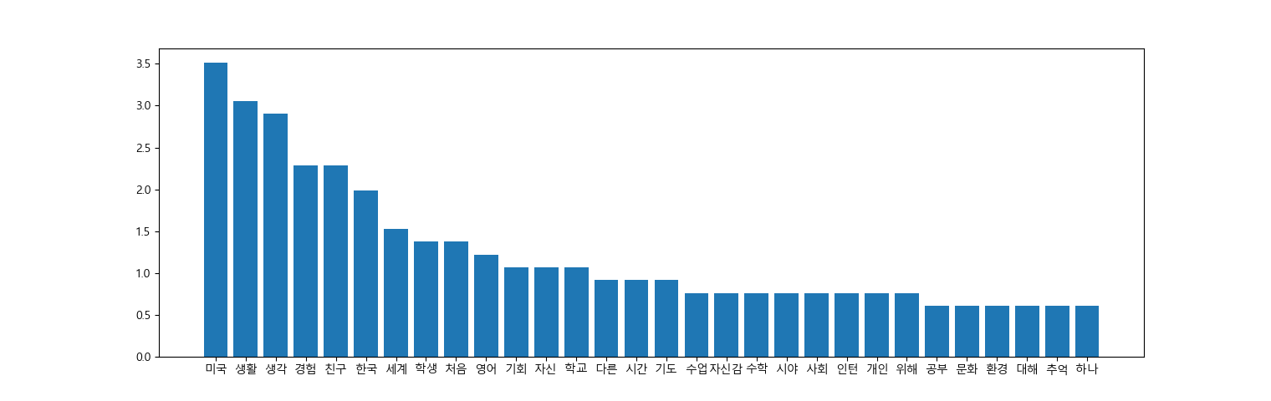
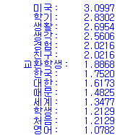

Implementation
이메일 확인을 제대로 하지 않아 기숙사 신청기한이 놓쳤을 경우 에어비앤비를 활용해 매물을구할 수 있습니다.
익숙했던 환경을 벗어나 4달 간 다른 문화를 가진 타지에서 좋은 사람들을 만나고 행복한 추억을 만든 캐나다에서의 생활은 평생 기억할 것 같습니다.
26

Slide 27
Challenges

Slide 28
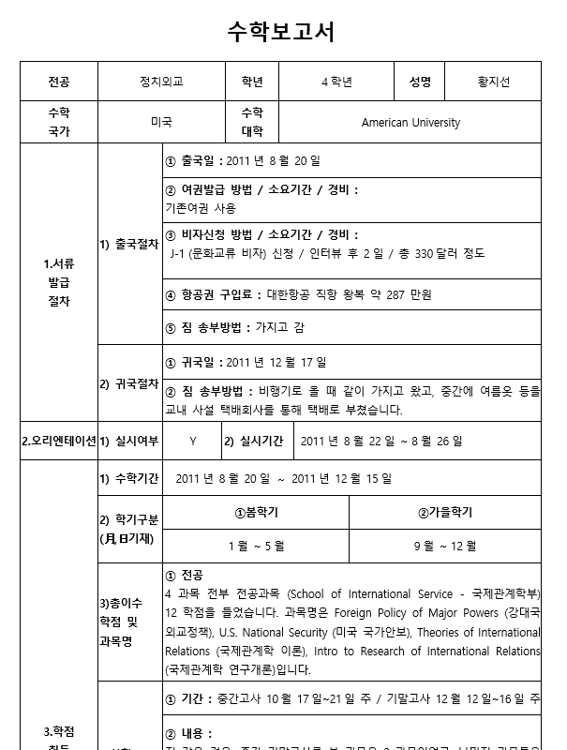
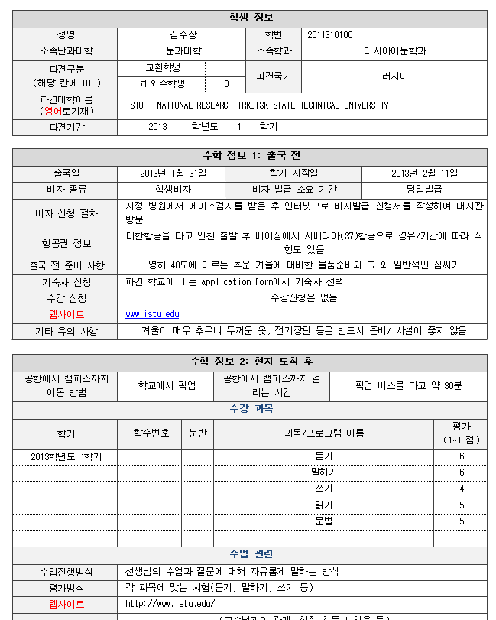
1. Different Format
Old 1183 (29%) | New 2905(71%)

Slide 29
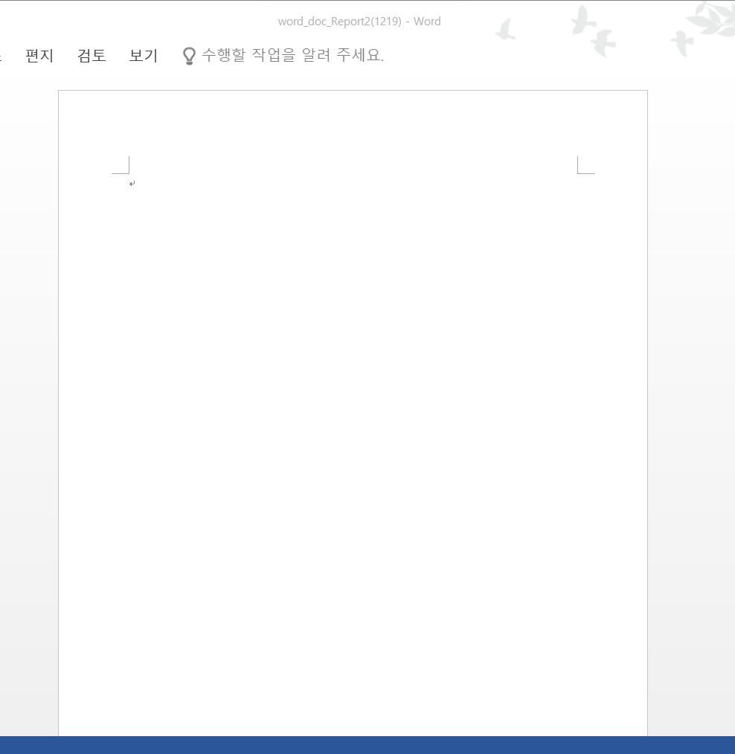
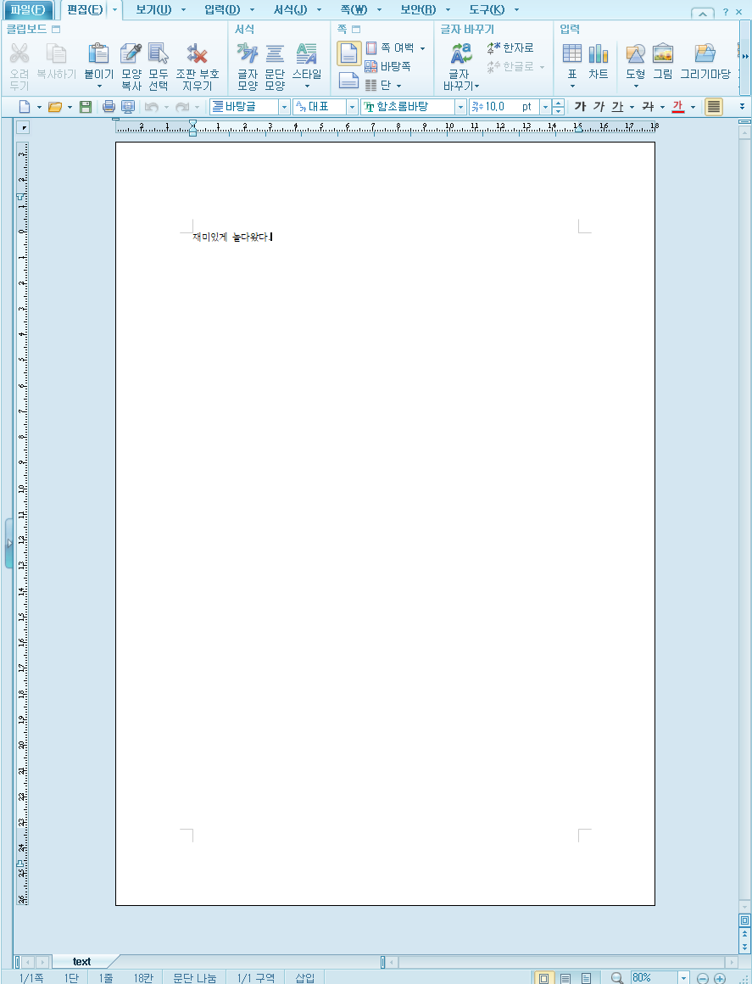
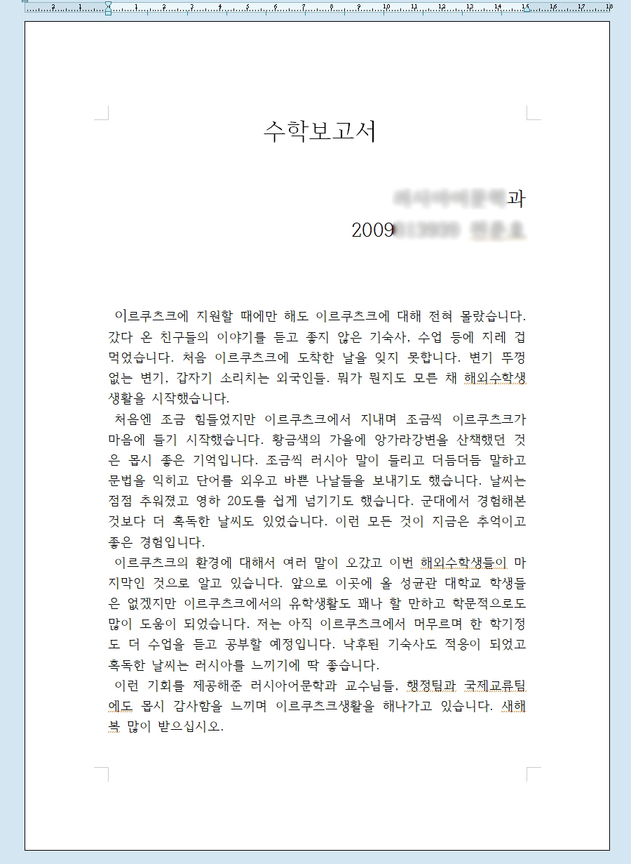
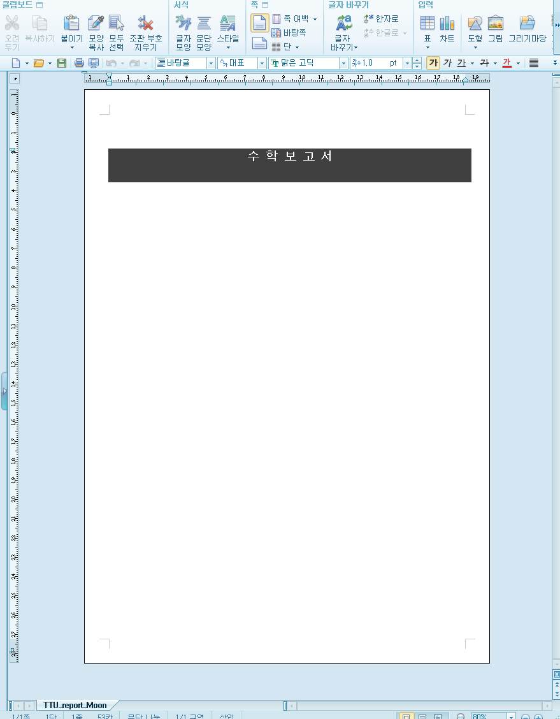
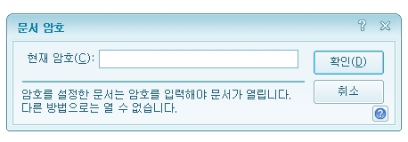
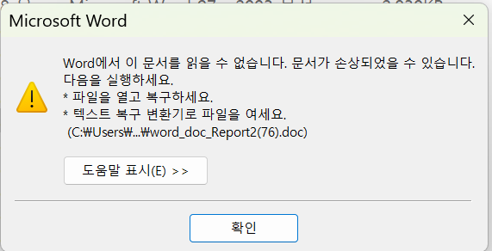
2. Files Useless-out of format

Slide 30
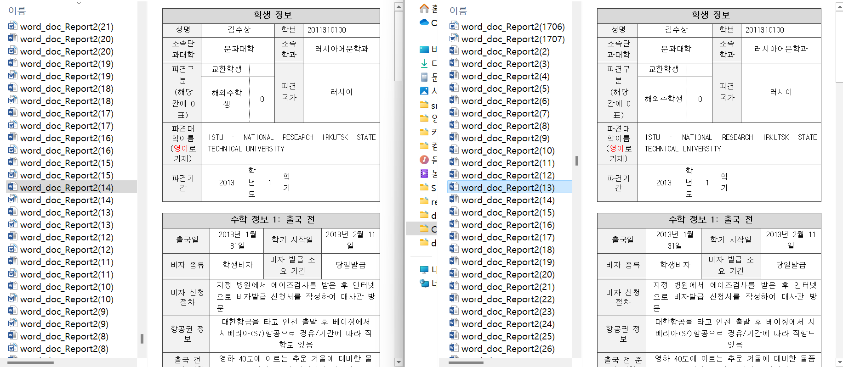
2. Files Useless - Redundant

Slide 31
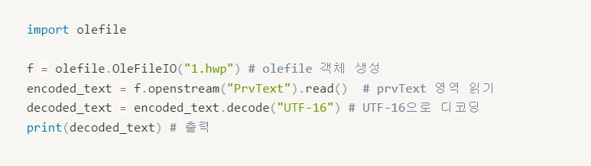
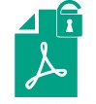
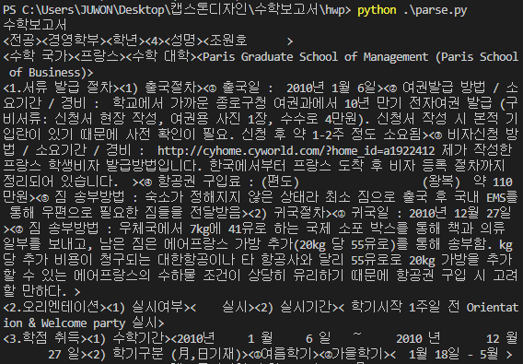
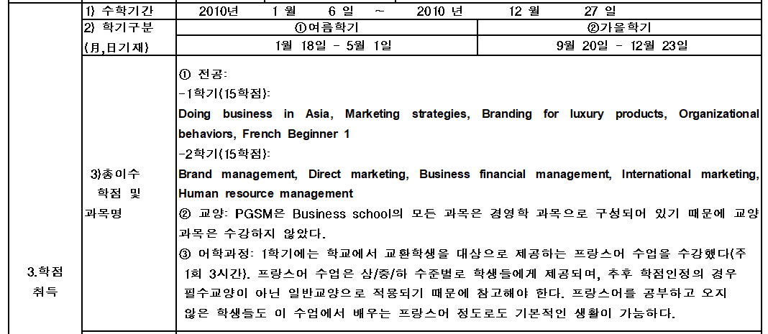
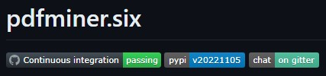
3. hwp
Data loss in hwp table occurs
31

Slide 32
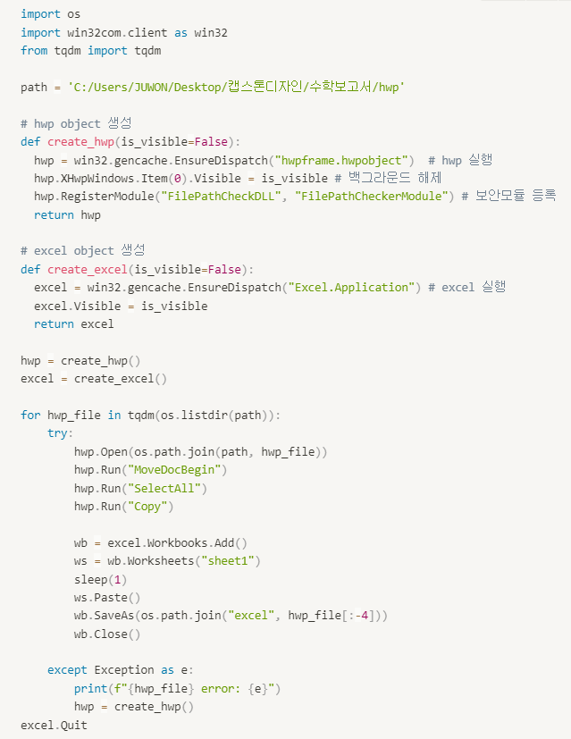
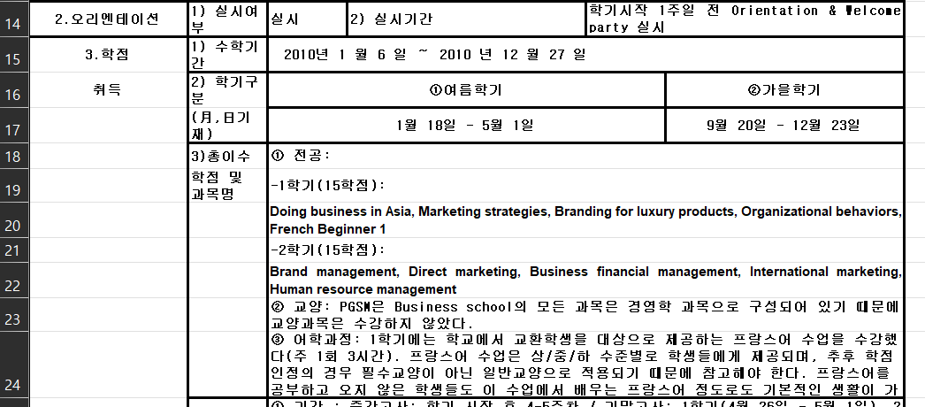
3. hwp
Converted hwp table to xlsx table, and parsed
32

Slide 33
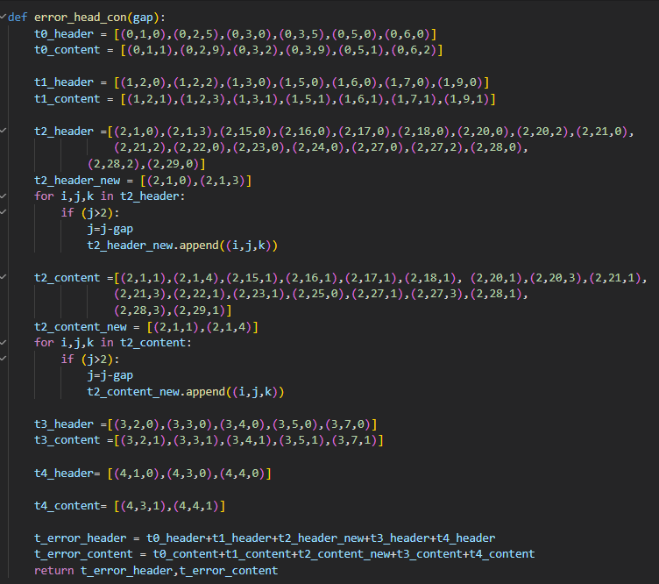
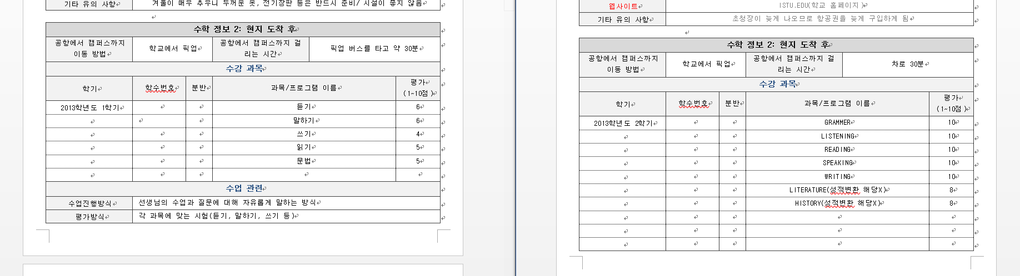

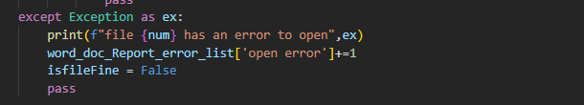
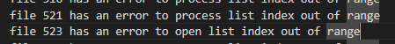
4. doc, docx
Table 2 has 30 rows if it’s not modified
Gap = 30-len(table[2].rows)
Fix header, contents for an error case
33

Slide 34
4. doc, docx

Slide 35
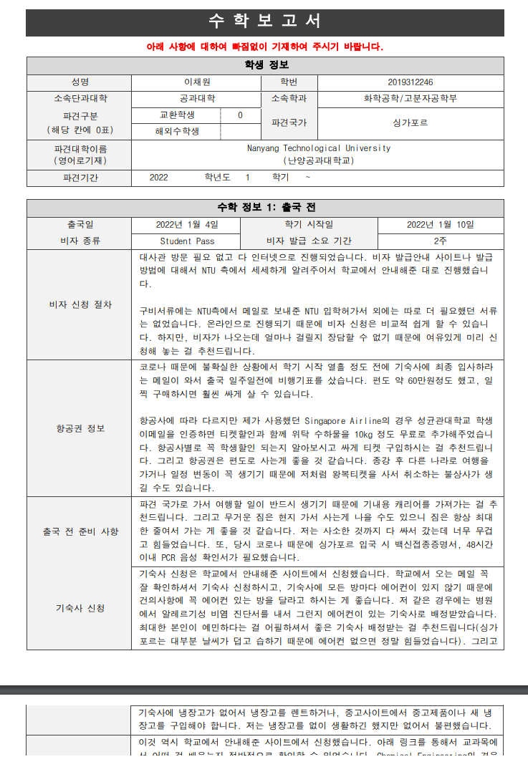
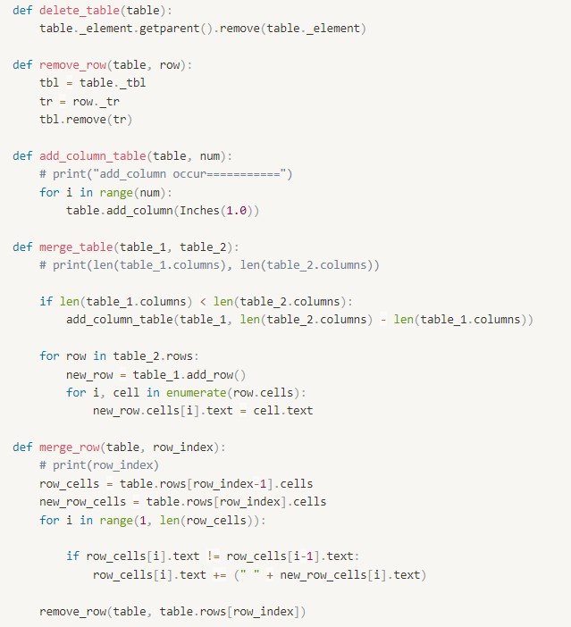


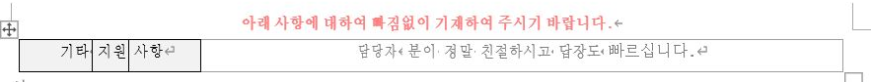
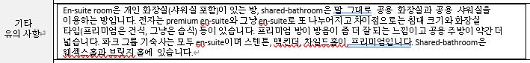
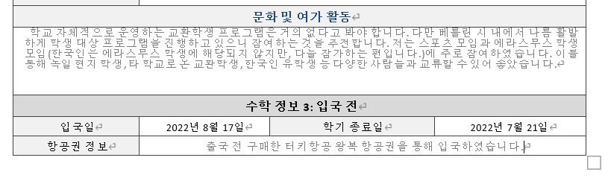
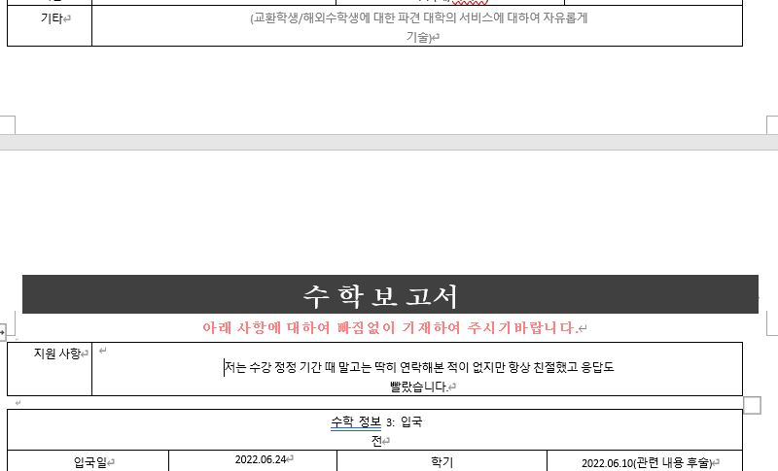

5. pdf
tabula: ‘\n’ and ‘ ‘are recognized as cells in the table
→ unnecessarily many rows and columns are added
PyPDF2: better than tabula... but still many rows and columns
pdfminer: many features but not for table in pdf
camelot: extract table well
→ if the table has gap, it divides the sentence.
35

Slide 36
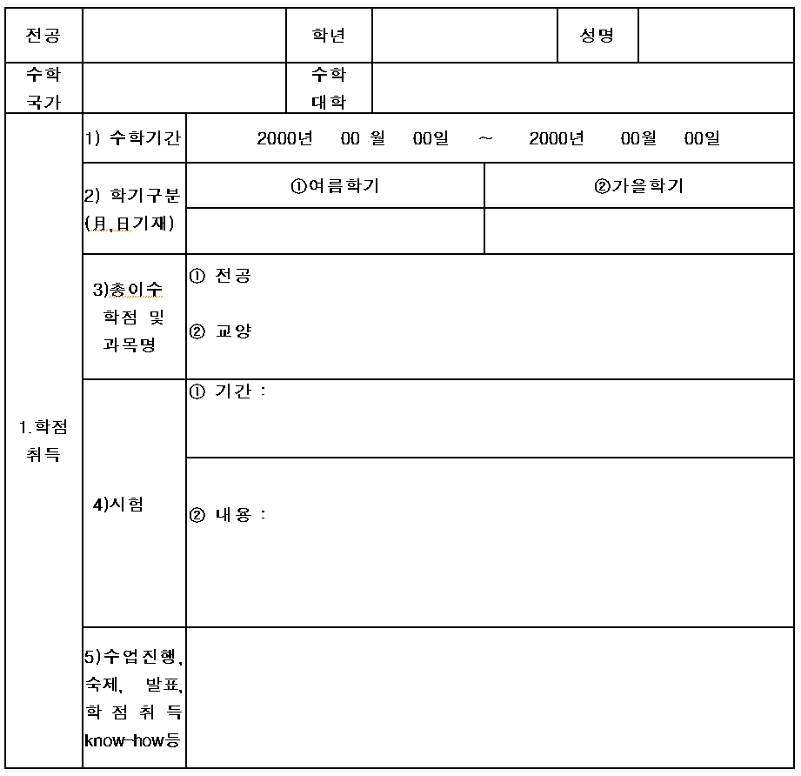
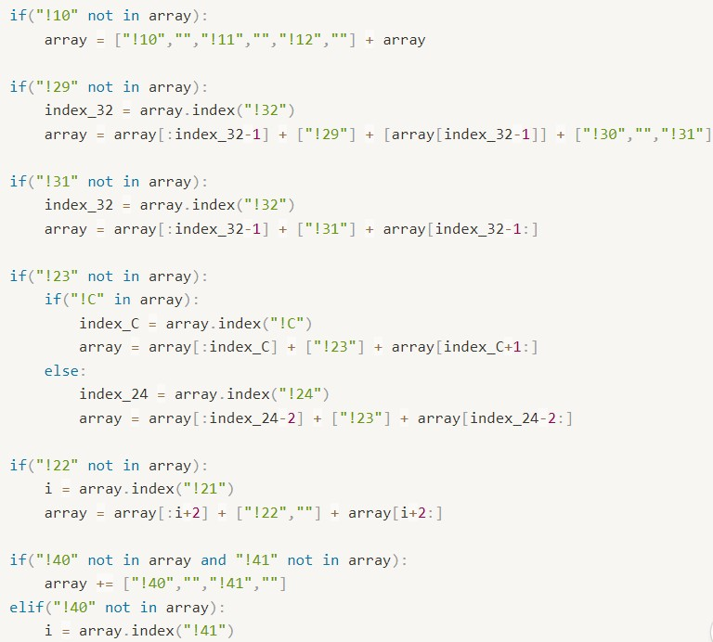

Old format
1. Index of cells vary from file to file
→ Change the algorithm to explore all cells
2. Table format vary by year
→ Based on the most recent of the old forms, increased
exception handling rates by adding if clauses
1. Doc to docx converter doesn’t work well (data loss)
2. There is no suitable library to extract data from hwp
3. Each online docx converter has limit
→ Open each file with win32com library, then
copy the content (same as ctrl + c) by code,
paste it to Word and save as docx
= 95%
36

Slide 37
Limitation

Slide 38
Limitation
Some report files are unavailable due to password, file corruption, etc.
→ Overall report volume is slightly less than original expectation.
Few files cannot apply the code to convert to csv.
→ It may require manual data processing for some additional files.
Operator should specify the words not to use as keyword. (대한, 때문, 개월, etc.)
38

Slide 39
Q&A

